Slide 1

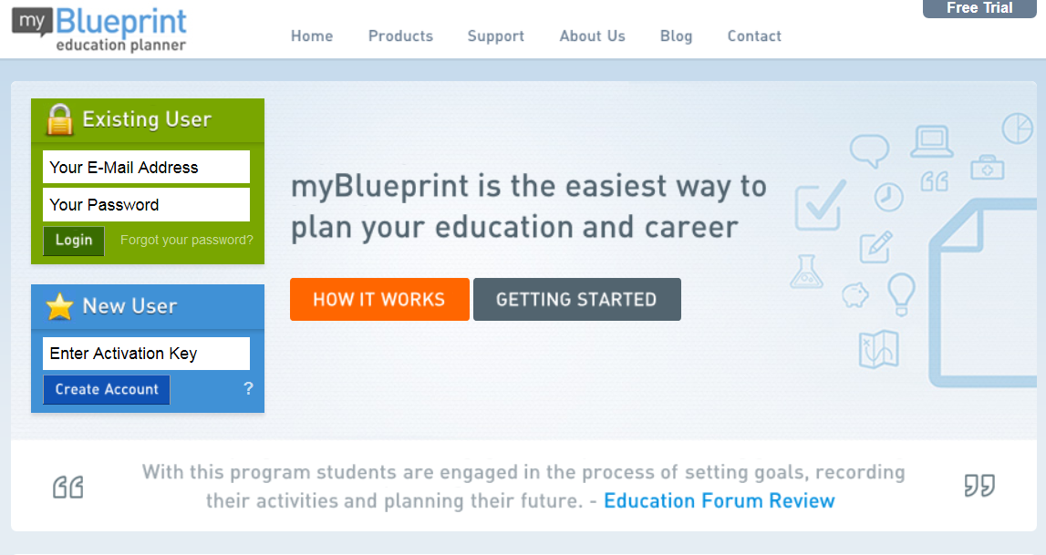
myBlueprint.ca > Create Account / Login
COURSE SELECTION STEPS

Slide 2
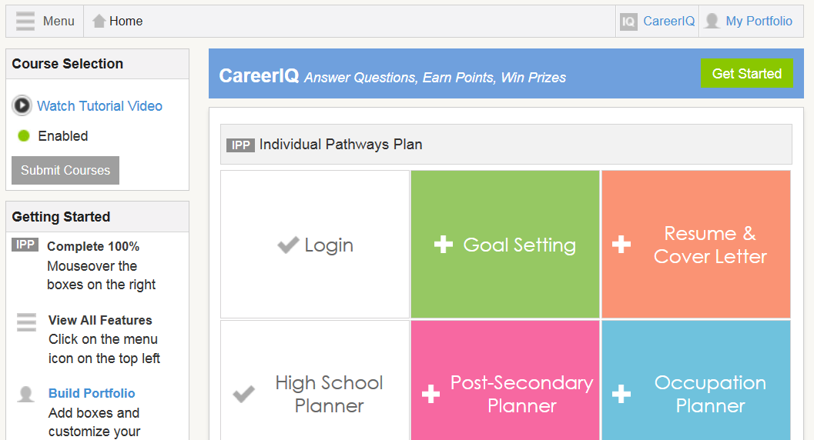
Dashboard > Submit Courses

Slide 3
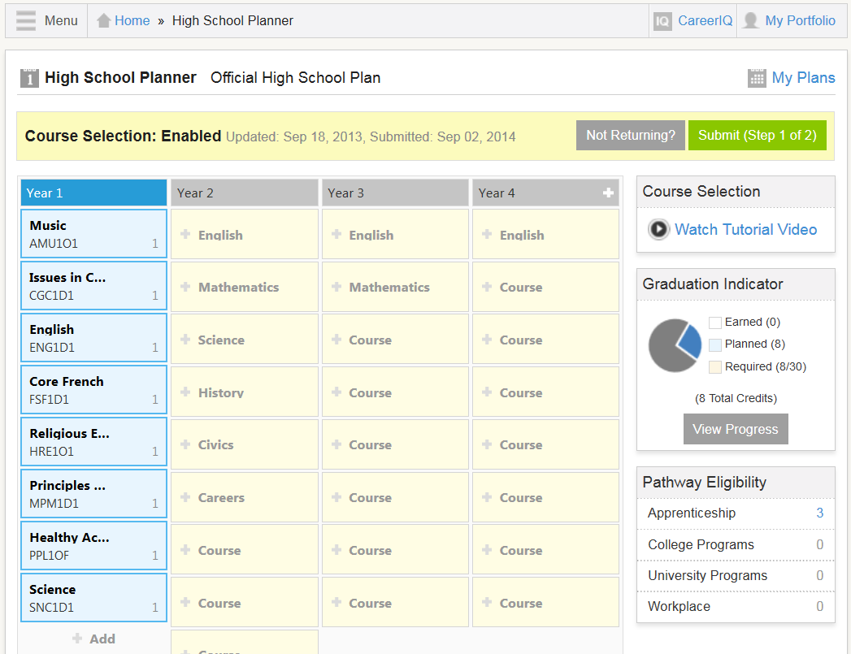
High School Planner > Add Courses

Slide 4
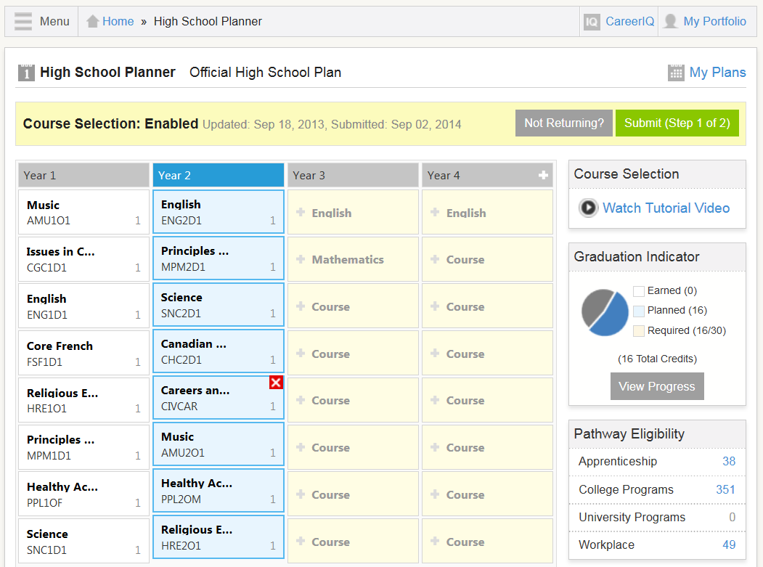
High School Planner > Submit (Step 1 of 2)

Slide 5
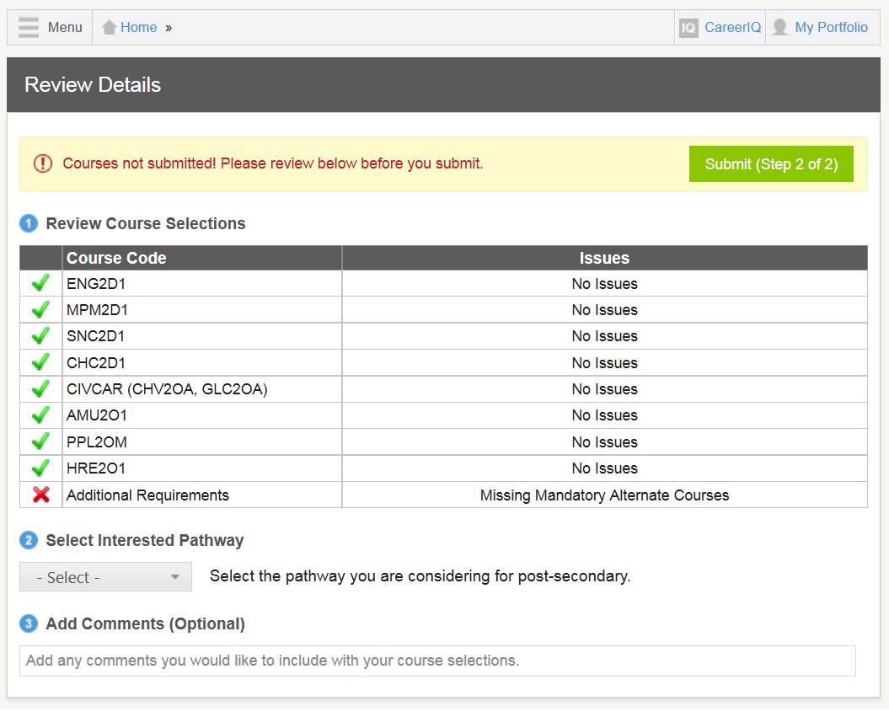
High School Planner > Submit (Step 2 of 2)

Slide 6
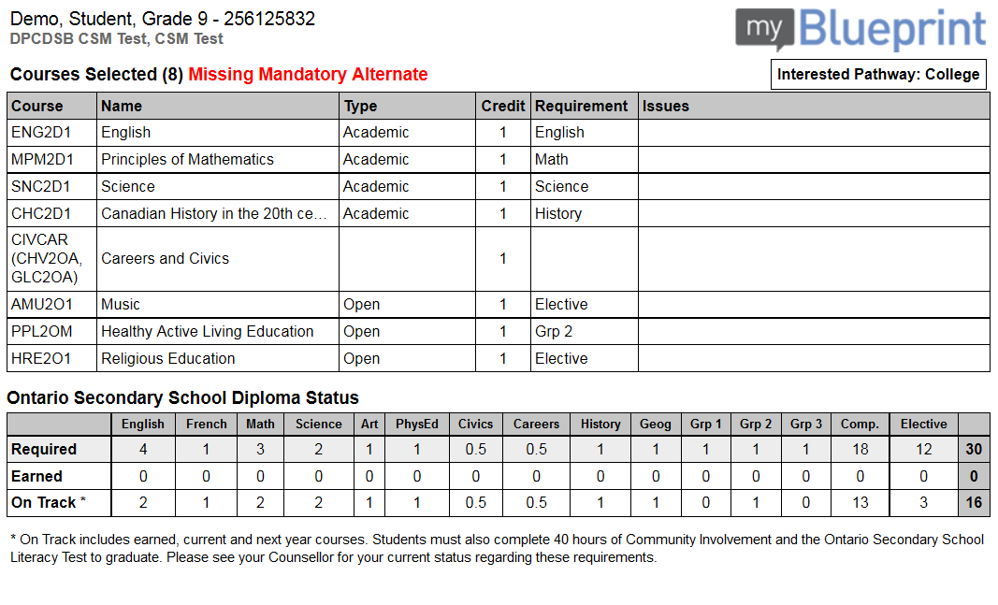
Print Sign-Off Sheet

